Slide 1
Matrix and Tensor Factorization & Deep Neural Network
CS&E, Sungkyunkwan University
Joon Hee Choi, PhD
Nov. 20, 2019

Slide 2
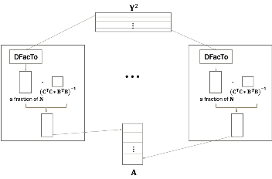
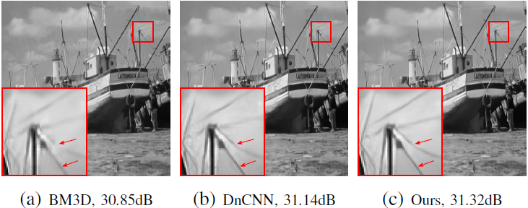
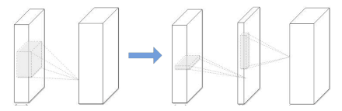
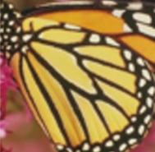

Research Interests
Machine Learning
Matrix/Tensor Factorization
Neural Network
Distributed
Tensor Factorization
Asynchronous
Distributed
Matrix Factorization
NN Model Compression
via Tensor Factorization
Integrating Image Denoisers
Image Processing / Computer Vision Application
Large Scale Machine Learning
NN Model Compression
Hyper Spectral Imaging
Hand Pose Estimation
Image Reconstruction for
Quanta Image Sensor
Real Image
Super-resolution

Slide 3
Large Scale Machine Learning
What is large scale machine learning?
Hardware revolution
Many-core processors
GPU
Solid-state drives
Existing ML algorithms
do NOT scale to the increasingly massive, distributed datasets
Develop novel ML algorithms that enable learning on and mining of massive datasets

Slide 4
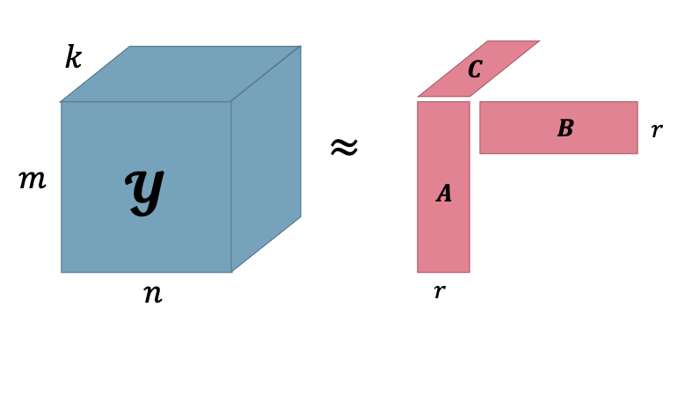
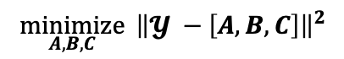
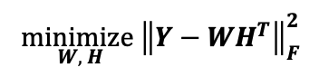
Matrix and Tensor Factorization
Matrix/Tensor factorization is an important linear algebraic tool that allows us to decompose a matrix or a tensor into products of matrices.
Matrix Factorization
Research Interests
Matrix and Tensor Factorization for Large Scale Datasets
Image Processing and Computer Vision using Matrix and Tensor Factorization
Tensor Factorization
$$\underset{W, H}{minimize}{{\left\|Y−WH^{T}\right\|}_{F}^{2}}$$
$$\underset{A,B,C}{minimize}{ {\left\|𝓨 −\left[A, B, C\right]\right\|}^{2}}$$

Slide 5
Neural Network
Neural Network is a computational learning system that uses a network of functions to understand and translate a data input of one form into a desired output, usually in another form. (from DeepAI)
Research Interests
Neural Network + Linear Combination
Image Processing and Computer Vision using Neural Network
Neural Network Model Compression

Slide 6
Distributed Factorization of Tensors (DFacTo)

Slide 7
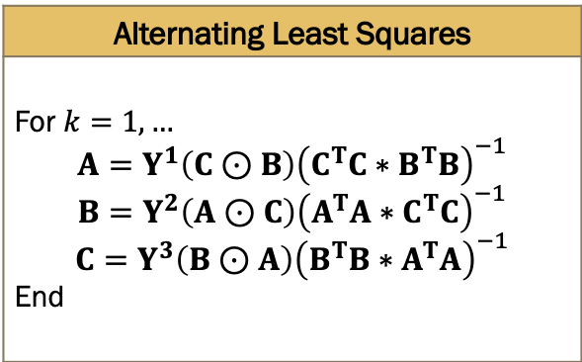
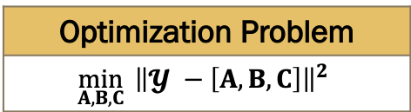
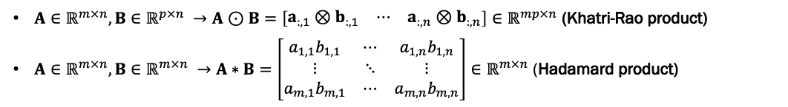
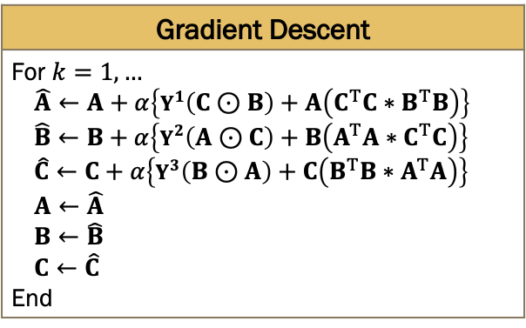
Tensor Factorization (CP Decomposition)
Tensor Factorization has computational challenge!
Optimization Problem
$${\min_{A,B,C}{ \left\|𝓨 −\left[A, B, C\right]\right\|}}^{2}$$
Alternating Least Squares
For $k=1,…$ $$A=Y^{1}\left(C⊙B\right){\left(C^{T}C∗B^{T}B\right)}^{−1}$$ $$B=Y^{2}\left(A⊙C\right){\left(A^{T}A∗C^{T}C\right)}^{−1}$$ $$C=Y^{3}\left(B⊙A\right){\left(B^{T}B∗A^{T}A\right)}^{−1}$$ End
Gradient Descent
For $k=1,…$ $$\hat{A}←A+α\left\{Y^{1}\left(C⊙B\right)+A\left(C^{T}C∗B^{T}B\right)\right\}$$ $$\hat{B}←B+α\left\{Y^{2}\left(A⊙C\right)+B\left(A^{T}A∗C^{T}C\right)\right\}$$ $$\hat{C}←C+α\left\{Y^{3}\left(B⊙A\right)+C\left(B^{T}B∗A^{T}A\right)\right\}$$ $$A←\hat{A}$$ $$B←\hat{B}$$ $$C←\hat{C}$$ End
$A∈ℝ^{m×n},B∈ℝ^{p×n} →A⊙B=\left[\begin{matrix}a_{:,1}⊗b_{:,1} & ⋯ & a_{:,n}⊗b_{:,n}\end{matrix}\right]∈ℝ^{mp×n}$ (Khatri-Rao product)
$A∈ℝ^{m×n},B∈ℝ^{m×n} →A∗B=\left[\begin{matrix}a_{1,1}b_{1,1} & ⋯ & a_{1,n}b_{1,n} \\ ⋮ & ⋱ & ⋮ \\ a_{m,1}b_{m,1} & ⋯ & a_{m,n}b_{m,n}\end{matrix}\right]∈ℝ^{m×n}$ (Hadamard product)
Even sparse tensor factorization needs lots of computations and large intermediate memory!!
The existing algorithms are difficult to parallelize!!

Slide 8
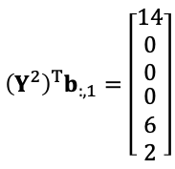
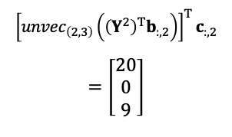
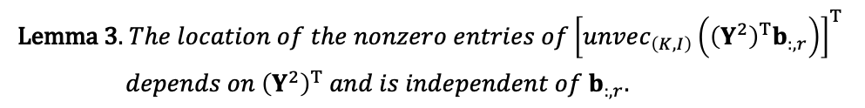
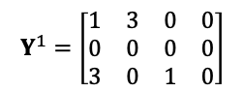
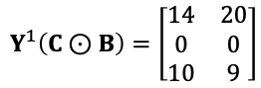
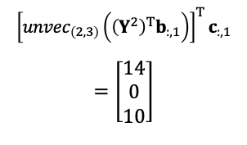
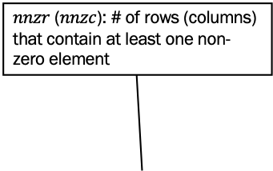
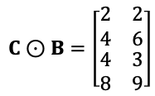
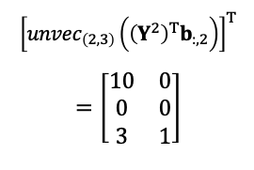
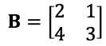
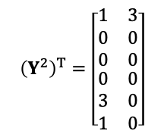
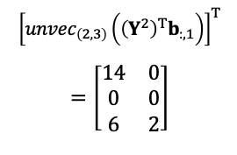
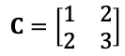
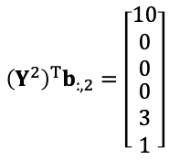
Distributed Factorization of Tensors (DFacTo)
$nnzr$ ($nnzc$): # of rows (columns) that contain at least one non-zero element
[Choi & Vishwanathan, 2014]
Lemma 1. ${\left[Y^{1}\left(C⊙B\right)\right]}_{:,r}={\left[{unvec}_{\left(K, I\right)}\left({\left(Y^{2}\right)}^{T}b_{:,r}\right)\right]}^{T}c_{:,r}$
Inputs
$$Y^{1}=\left[\begin{matrix}\begin{matrix}1 & 3\end{matrix} & \begin{matrix}0 & 0\end{matrix} \\ \begin{matrix}0 & 0\end{matrix} & \begin{matrix}0 & 0\end{matrix} \\ \begin{matrix}3 & 0\end{matrix} & \begin{matrix}1 & 0\end{matrix}\end{matrix}\right]$$
Lemma 2. $\# of nonzeros in\left({\left(Y^{2}\right)}^{T}b_{:,r}\right)≤nnzr\left({\left(Y^{2}\right)}^{T}\right)$ and $nnzc\left(Y^{2}\right)$
Lemma 3. $The location of the nonzero entries of{\left[unvec_{\left(K, I\right)}\left({\left(Y^{2}\right)}^{T}b_{:,r}\right)\right]}^{T}$
$depends on {\left(Y^{2}\right)}^{T}$ $and is independent of b_{:,r}.$
$${\left(Y^{2}\right)}^{T}=\left[\begin{matrix}\begin{matrix}1 & 3 \\ 0 & 0 \\ 0 & 0\end{matrix} \\ \begin{matrix}0 & 0 \\ 3 & 0 \\ 1 & 0\end{matrix}\end{matrix}\right]$$
$$B=\left[\begin{matrix}2 & 1 \\ 4 & 3\end{matrix}\right]$$
$$C=\left[\begin{matrix}1 & 2 \\ 2 & 3\end{matrix}\right]$$
DFacTo
$${\left(Y^{2}\right)}^{T}b_{:,1}=\left[\begin{matrix}\begin{matrix}14 \\ 0 \\ 0\end{matrix} \\ \begin{matrix}0 \\ 6 \\ 2\end{matrix}\end{matrix}\right]$$
$${\left[{unvec}_{\left(2,3\right)}\left({\left(Y^{2}\right)}^{T}b_{:,1}\right)\right]}^{T}$$
$$=\left[\begin{matrix}\begin{matrix}14 \\ 0 \\ 6\end{matrix} & \begin{matrix}0 \\ 0 \\ 2\end{matrix}\end{matrix}\right]$$
$${\left[{unvec}_{\left(2, 3\right)}\left({\left(Y^{2}\right)}^{T}b_{:,1}\right)\right]}^{T}c_{:,1}$$
$$=\left[\begin{matrix}14 \\ 0 \\ 10\end{matrix}\right]$$
Naïve Algorithm
$$C⊙B=\left[\begin{matrix}\begin{matrix}2 \\ 4\end{matrix} & \begin{matrix}2 \\ 6\end{matrix} \\ \begin{matrix}4 \\ 8\end{matrix} & \begin{matrix}3 \\ 9\end{matrix}\end{matrix}\right]$$
reshape
multiply
$${\left(Y^{2}\right)}^{T}b_{:,2}=\left[\begin{matrix}\begin{matrix}10 \\ 0 \\ 0\end{matrix} \\ \begin{matrix}0 \\ 3 \\ 1\end{matrix}\end{matrix}\right]$$
$${\left[{unvec}_{\left(2, 3\right)}\left({\left(Y^{2}\right)}^{T}b_{:,2}\right)\right]}^{T}$$
$$=\left[\begin{matrix}\begin{matrix}10 \\ 0 \\ 3\end{matrix} & \begin{matrix}0 \\ 0 \\ 1\end{matrix}\end{matrix}\right]$$
$${\left[{unvec}_{\left(2, 3\right)}\left({\left(Y^{2}\right)}^{T}b_{:,2}\right)\right]}^{T}c_{:,2}$$
$$=\left[\begin{matrix}20 \\ 0 \\ 9\end{matrix}\right]$$
$$Y^{1}\left(C⊙B\right)=\left[\begin{matrix}\begin{matrix}14 \\ 0 \\ 10\end{matrix} & \begin{matrix}20 \\ 0 \\ 9\end{matrix}\end{matrix}\right]$$

Slide 9

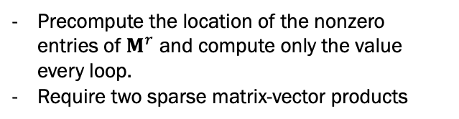
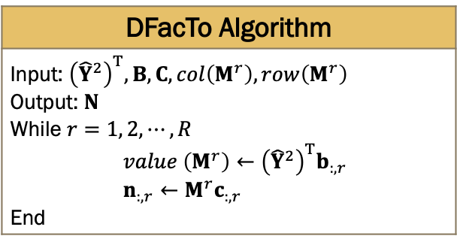
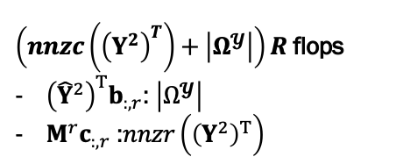
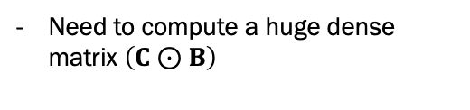
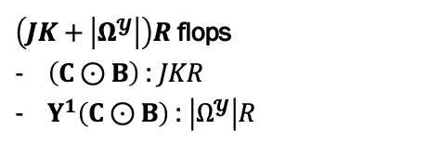
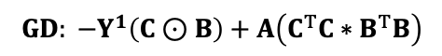
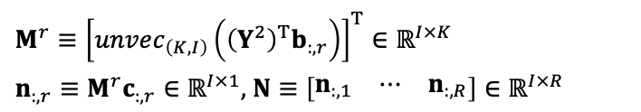
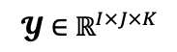
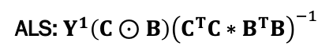
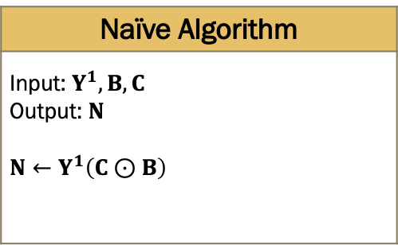
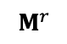
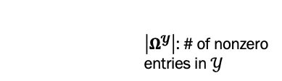
Distributed Factorization of Tensors (DFacTo)
ALS: $Y^{1}\left(C⊙B\right){\left(C^{T}C∗B^{T}B\right)}^{−1}$
${M^{r}≡\left[unvec_{\left(K, I\right)}\left({\left(Y^{2}\right)}^{T}b_{:,r}\right)\right]}^{T}∈ℝ^{I×K}$
$n_{:,r}≡M^{r}c_{:,r}∈ℝ^{I×1},$ $N≡\left[\begin{matrix}n_{:,1} & ⋯ & n_{:,R}\end{matrix}\right]∈ℝ^{I×R}$
$$GD: −Y^{1}\left(C⊙B\right)+A\left(C^{T}C∗B^{T}B\right)$$
DFacTo Algorithm
Input: ${\left({\hat{Y}}^{2}\right)}^{T}, B, C, col\left(M^{r}\right), row\left(M^{r}\right)$ Output: $N$ While $r=1, 2, ⋯, R$ $value \left(M^{r}\right)←{\left({\hat{Y}}^{2}\right)}^{T}b_{:,r}$ $n_{:,r}←M^{r}c_{:,r}$ End
Naïve Algorithm
Input: $Y^{1}, B, C$ Output: $N$ $N←Y^{1}\left(C⊙B\right)$
$$M^{r}$$
1
2
3
4
Precompute the location of the nonzero entries of $M^{r}$ and compute only the value every loop.
Require two sparse matrix-vector products
Need to compute a huge dense matrix $\left(C⊙B\right)$
$\left(nnzc\left({\left(Y^{2}\right)}^{T}\right)+\left|Ω^{𝓨}\right|\right)R$ flops
${\left({\hat{Y}}^{2}\right)}^{T}b_{:,r}$: $\left|Ω^{𝓨}\right|$
$M^{r}c_{:,r}$ :$nnzr\left({\left(Y^{2}\right)}^{T}\right)$
$$≪$$
$\left(JK+\left|Ω^{𝓨}\right|\right)R$ flops
$\left(C⊙B\right)$: $JKR$
$Y^{1}\left(C⊙B\right)$: $\left|Ω^{𝓨}\right|R$
$$𝓨∈ℝ^{I×J×K}$$
$\left|Ω^{𝓨}\right|$: # of nonzero entries in $𝒴$

Slide 10
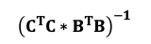

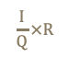

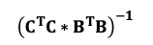
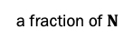
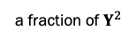
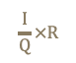
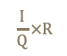
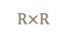
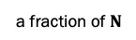
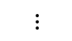
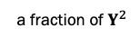

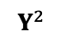
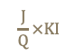






Parallelizing DFacTo on a Cluster
ALS: $Y^{1}\left(C⊙B\right){\left(C^{T}C∗B^{T}B\right)}^{−1}$
$$GD: −Y^{1}\left(C⊙B\right)+A\left(C^{T}C∗B^{T}B\right)$$
$$Y^{2}$$
$$J×KI$$
$$\frac{J}{Q}×KI$$
a fraction of $Y^{2}$
$$⋮$$
a fraction of $Y^{2}$
$$\frac{J}{Q}×KI$$
Node 1
DFacTo
DFacTo
Node Q
$$R×R$$
$$⋯$$
$$R×R$$
$$\frac{I}{Q}×R$$
$$⋅$$
$$\frac{I}{Q}×R$$
$$⋅$$
$${\left(C^{T}C∗B^{T}B\right)}^{−1}$$
$${\left(C^{T}C∗B^{T}B\right)}^{−1}$$
a fraction of $N$
a fraction of $N$
$$\frac{I}{Q}×R$$
$$I×R$$
$$\frac{I}{Q}×R$$
$$⋮$$
$$A$$
Use MPI_Allgatherv
Notes:
- row wise partitioning
- Applying CSR format is always safe if we distribute data to the nodes in this way because our algorithm only depends on non zero pattern of Y2.
- We use the MPI_allgatherv which is efficient collective communication method and the communication happens only once.
- So DFacTo uses CSR format to reduce time and space and is easy to distribute data.

Slide 11


Experiment1 (Scaling on Real-World Datasets)
Times per iteration (in seconds) on datasets which can fit in a single machine ($R=10$).
(secs)
ALS
GD
Dataset | DFacTo (ALS) | GigaTensor⁽¹⁾ | CPALS⁽²⁾ | $$\text{DFacTo}\text{ (}\text{GD}\text{)}$$ | CPOPT⁽²⁾
Yelp | 9.52 | 26.82 | 46.52 | 13.57 | 45.90
Cellartracker | 23.89 | 80.65 | 118.25 | 35.82 | 130.32
NELL-2 | 32.59 | 186.30 | 376.10 | 80.79 | 386.25
Beeradvocate | 43.84 | 224.29 | 364.98 | 94.85 | 481.06
Ratebeer | 44.20 | 240.80 | 396.63 | 87.36 | 349.18
NELL-1⁽³⁾ | 322.45 | 772.24 | - | 742.67 | -
GigaTensor: Kolda and Bader – Tensor Toolbox (2009)
CPALS/CPOPT: Kang et al. (2012)
Never-Ending Language Learning (CMU)
2.9M x 2.1M x 25.5M
# of nonzeros: 143.7M
Notes:
NELL1: nnzr(Y) does not reduce linearly in terms of increase of nodes.

Slide 12


Experiment2 (Scaling across Machines)
Total Time and CPU time per iteration (in seconds) as a function of number of machines
 | DFacTo (ALS) |  |  |  | DFacTo (GD)
 | NELL-1 |  | Amazon |  | NELL-1 |  | Amazon
Machines | Total | CPU | Total | CPU | Total | CPU | Total | CPU
1 | 322.45 | 322.45 | - | - | 742.67 | 104.23 | - | -
2 | 205.07 | 167.29 | - | - | 492.38 | 55.11 | - | -
4 | 141.02 | 101.58 | 480.21 | 376.71 | 322.65 | 28.55 | 1143.7 | 127.57
8 | 86.09 | 62.19 | 292.34 | 204.41 | 232.41 | 16.24 | 727.79 | 62.61
16 | 81.24 | 46.25 | 179.23 | 98.07 | 178.92 | 9.70 | 560.47 | 28.61
32 | 90.31 | 34.54 | 142.69 | 54.60 | 209.39 | 7.45 | 471.91 | 15.78
The scalability of DFacTo with respect to the number of machines on the Amazon dataset
DFacTo(ALS)
DFacTo(GD)

Slide 13



Experiment3 (Synthetic Data)
Time per iteration (in seconds) on synthetic datasets. The number of non-zero elements is ${10}^{6}$ , and the dimensions of the tensor are varied.
(secs)
I=J=K | DFacTo(ALS) | GigaTensor | CPALS | DFacTo(GD) | CPOPT
$${10}^{4}$$ | 1.14 | 2.80 | 5.10 | 2.32 | 5.21
$${10}^{5}$$ | 2.72 | 6.71 | 6.11 | 5.87 | 11.70
$${10}^{6}$$ | 7.26 | 11.86 | 16.54 | 16.51 | 29.13
$${10}^{7}$$ | 41.64 | 38.19 | 175.57 | 121.30 | 202.71
Time per iteration (in seconds) on synthetic datasets. The dimensions of the tensor are varied and the number of non-zero elements is set to $2I$.
(secs)
I=J=K | DFacTo(ALS) | GigaTensor | CPALS | DFacTo(GD) | CPOPT
$${10}^{4}$$ | 0.05 | 0.09 | 0.52 | 0.09 | 0.57
$${10}^{5}$$ | 0.92 | 1.61 | 1.50 | 1.81 | 2.98
$${10}^{6}$$ | 12.06 | 22.08 | 15.84 | 21.74 | 26.04
$${10}^{7}$$ | 144.48 | 251.89 | 214.37 | 275.19 | 324.20

Slide 14
Optimal Combination of Image Denoisers
Notes:
I will explain optimal combination of image denoisers.

Slide 15






One Fit All?
Classical Method VS Deep Learning:
BM3D, 30.85dB
DnCNN, 31.14dB
BM3D, 26.80dB
DnCNN, 26.49dB
Bad Choice of Noise Level:
Input, $σ$=20
19.60dB
REDNet, $trained at \hat{σ}$=10
20.71dB
REDNet, trained at $\hat{σ}$=30
27.16dB
Notes:
Image denoising is a task estimating an original image from an observed image corrupted by noise, for example Gaussian noise.
There are many existing image denoising methods, especially, deterministic methods and learning based methods.

Slide 16





Problem Statement
Some Notation:
Imaging Model:
Noise: iid Gaussian
Noisy image
(unknown) clean image
Denoiser:
Examples: BM3D, Non-local Means, Wavelet Shrinkage, Total Variation, etc
Combination of Denoisers:
Require
Goal: Can we find an optimal combination of denoisers?
Notes:
Image denoising is a task estimating an original image from an observed image corrupted by noise, for example Gaussian noise.
There are many existing image denoising methods, especially, deterministic methods and learning based methods.

Slide 17








Formulating Optimization
How about this?
or estimated MSE
Equivalent Formulation:
available
or estimated MSE

Slide 18




Solving the Optimization
First Order Approximation
(*)
Lemma 1 [Choi, Elgendy and Chan, 2019]
Solution of (*) is

Slide 19

Overall Pipeline
Booster
MSE estimation
Convex optimization

Slide 20
MSE Estimation
Noisy input
MSE Estimator
MSE
(of denoised)
Denoised Image

Slide 21



Our MSE Estimator
$i$-th patch of $y$
$i$-th patch of ${\hat{z}}_{k}$
Two Key Properties
Input Pair ($y, {\hat{z}}_{k}$)
Better estimate than an input ${\hat{z}}_{k}$
Patch-based Inputs
Control dimensionality of input
Good approximation to full image as input

Slide 22
The effect of Booster Network
Improve the combined estimates by enhancing the contrast and recover lost details.
23.55dB, 0.6317
Before Booster
24.75dB, 0.6334
After Booster
26.33dB, 0.7483
Before Booster
29.51dB, 0.7680
After Booster

Slide 23















Our Booster Network
The existing boosters
$${\hat{z}}^{\left(0\right)}$$
$${\hat{z}}^{\left(1\right)}$$
…
$${\hat{z}}^{\left(T−1\right)}$$
$${\hat{z}}^{\left(T\right)}$$
$$B$$
$$B$$
$$B$$
$$y$$
Our booster
$${\hat{z}}^{\left(0\right)}$$
$${\hat{z}}^{\left(1\right)}$$
…
$${\hat{z}}^{\left(T−1\right)}$$
$${\hat{z}}^{\left(T\right)}$$
$$B_{1}$$
$$B_{2}$$
$$B_{T}$$
$$y$$
Skip connections

Slide 24


Experiment1 (Noise Mismatch)
DnCNN, $\hat{σ}=30$
$\text{2}\text{4}\text{.}\text{56}\text{dB}\text{, }$0.6853
DnCNN, $\hat{σ}=40$
$\text{2}\text{4}\text{.}\text{6}\text{1}\text{dB}\text{, }$0.6449
Ground Truth
DnCNN, Before
25.14dB, 0.6963
DnCNN, After
25.41dB, 0.7081

Slide 25






Experiment2 (Class Mismatch)
Ground Truth
REDNet, Building
$\text{2}\text{9}\text{.}\text{53}\text{dB}\text{, }$0.9094
REDNet, Face
$\text{2}\text{8}\text{.}\text{62}\text{dB}\text{, }$0.8926
REDNet, Flower
$\text{2}\text{8}\text{.}\text{89}\text{dB}\text{, }$0.8964
Input
$$\text{2}\text{2}\text{.}\text{56}\text{dB}\text{, 0.5884}$$
REDNet, Before
$\text{2}\text{9.52}\text{dB}\text{, }$0.9089
REDNet, After
$\text{2}\text{9.69}\text{dB}\text{, }$0.9203

Slide 26






Experiment3 (Characteristic Mismatch)
Different Denoiser Types: BM3D, DnCNN, FFDNet, REDNet
Ground Truth
Input, $σ=50$
$\text{15.03}\text{dB}\text{, }$0.2013
BM3D
$\text{2}\text{4}\text{.}\text{77}\text{dB}\text{, }$0.6883
DnCNN
24.35dB, 0.6838
FFDNet
$\text{2}\text{4}\text{.39}\text{dB}\text{, }$0.6865
REDNet
$\text{2}\text{4.31}\text{dB}\text{, }$0.6838
Before Booster
$\text{2}\text{4.79}\text{dB}\text{, }$0.6915
After Booster
$\text{25.}\text{76}\text{dB}\text{, }$0.7113
The ConsensusNet is used to integrate BM3D, DnCNN, REDNet, and FFDNet
The testing image is Bear (size 321×481) from BSD500.

Slide 27
Conclusion
Usage:
Combining multiple weak denoisers due to model mismatch
Applicable to ANY denoiser
Extendable to ANY estimator

Slide 28
Short-term Future Work
Notes:
I will explain optimal combination of image denoisers.

Slide 29
Research Interests
Machine Learning
Matrix/Tensor Factorization
Neural Network
Distributed
Tensor Factorization
Asynchronous
Distributed
Matrix Factorization
NN Model Compression
via Tensor Factorization
Integrating Image Denoisers
Hyper Spectral Imaging
Hand Pose Estimation
Image Reconstruction for
Quanta Image Sensor
Real Image
Super-resolution

Slide 30



Deep Neural Network Model Compression
Deep Neural Network’s Challenges:
Develop various model compression methods
Low-rank Matrix/Tensor decomposition can estimate the informative parameters of the deep CNNs.
Weight Sharing (Quantization)
Huffman Encoding
Hardware for Deep Learning
original
CNN
low-rank constraint
CNN

Slide 31


Deep Neural Network for Real Image
DNN-based Image Processing’s Challenges: DSLR or smartphone companies still uses traditional image processing methods for camera pipeline modules. Academic NN models usually generate visual artifacts for real images and cannot meet product level quality.
Develop DNN-based framework replacing current camera modules.
Use two different NN models for flat region and texture region, respectively.
→ Image Denoising, Super Resolution
Neural Network1
Flat Region
patches
Neural Network2
patches
LR
Texture
Region
SR
HR

Slide 32
Asynchronous Distributed ML Model
Challenges: Since most of machine learning models have to synchronize between nodes for each iteration, if many nodes (machines) are used, then machine learning models need to spend a lot of time for the synchronization.
Develop an approximation method for avoid the synchronization between nodes.
Asynchronous Distributed Matrix factorization
Asynchronous Multinomial Logistic Regression

Slide 33
Other Research Interests (Mid-term)
Generative Adversarial Networks (GAN)
Reinforcement learning
Learning To Learn
Autonomous Driving
Notes:
“GAN”: Two neural networks contest with each other in a zero-sum game framework. This technique can generate photographs that look at least superficially authentic to human observers, having many realistic characteristics.
“learning to learn” intends to design models that can learn new skills or adapt to new environments rapidly with a few training examples. There are three common approaches: 1) learn an efficient distance metric (metric-based); 2) use (recurrent) network with external or internal memory (model-based); 3) optimize the model parameters explicitly for fast learning (optimization-based).
Reinforcement learning is the training of machine learning models to make a sequence of decisions. The agent learns to achieve a goal in an uncertain, potentially complex environment. In reinforcement learning, an artificial intelligence faces a game-like situation.

Slide 34
Publication List
Joon Hee Choi, Omar Elgendy and Stanley Chan, Optimal Combination of Image Denoisers, TIP, 28(8), pp. 4016 - 4031, 2019.
Joon Hee Choi, Omar Elgendy and Stanley Chan, Image Reconstruction for Quanta Image Sensors Using Deep Neural Networks, ICASSP, 2018.
Chiman Kwan, Joon Hee Choi, Stanley Chan, Jin Zhou and Bence Budavari. A Super-Resolution and Fusion Approach to Enhancing Hyperspectral Images. Remote Sensing, 10(9), 1416, 2018.
Chiman Kwan, Joon Hee Choi, Stanley Chan, Jin Zhou and Bence Budavari, Resolution Enhancement for Hyperspectral Images: A Super-Resolution and Fusion Approach, ICASSP, pp 6180-6184, 2017.
Chien-Sheng Liao, Joon Hee Choi, Delong Zhang, Stanley H. Chan and Ji-Xin Cheng. Denoising Stimulated Raman Spectroscopic Images by Total Variation Minimization, Journal of Physical Chemistry C, 119 (33), pp. 19397-19403, July, 2015.
Chiho Choi, Ayan T. Sinha, Joon Hee Choi, Sujin Jang and Karthik Ramani, Collaborative Filtering Approach to Real-Time Hand Pose Estimation, ICCV, pp. 2336-2344, 2015.
Joon Hee Choi and S.V.N. Vishwanathan, DFacTo: Distributed Factorization of Tensors, NIPS, pp. 1296-1304, 2014.

Slide 35
Q & A

Slide 36
Thank you!!

